Slide 1
System and Network Administration
Getting Started:
System Requirements

Slide 2
Layers of Complex Software
Any complete OS (Win, OSX, Linux,…)
VM (Guest OS)
Device Drivers
Virtual Devices
First step:
Making sure all of these components are ready to work together …
Other
Apps
VirtualBox
or Vmware, Docker, Android Studio, …
(Level 2 Hypervisor)
Virtual Drivers
Windows (Host OS)
Hyper-V
Win OS runs as a VM
(Level 1 Hypervisor)
Device Drivers
--- --- --- Hardware --- --- ---
Trusted Platform Module (TPM)
CPU
-----------
HW Virt
Memory
,,, I/O Devices ,,,
BIOS
Core allocation
Memory isolation

Slide 3
Layers of Complex Software
Any complete OS (Win, OSX, Linux)
VM (Guest OS)
A “Level 2 Hypervisor” runs as a regular app and exposes virtual devices to the “Guest OS”
Device Drivers
Virtual Devices
Other
Apps
VirtualBox
or Vmware, Docker, Android Studio, etc.
Virtual Drivers
Windows (Host OS)
The “Host OS” passes virtual driver instructions to the CPU through its “real” device drivers
Device Drivers
--- --- --- Hardware --- --- ---
Every operating system is complex software all by itself
To run one OS inside another OS (as a Virtual Machine), we need a “translation layer”

Slide 4
Getting Started
Windows system: /Cleanup-Image /RestoreHealth
CPU: Virtualization Enabled in the BIOS
Install Virtualbox
- Run as Administrator
Create a VM
Step 1 is only for Windows 10/11
Step 2 is for Windows and Linux
Mac M1 requires a special setup

Slide 5




Slide 6
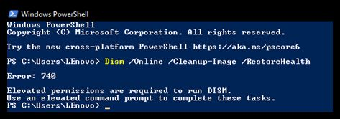
Getting Started: 1) Windows system
We have to run two apps from the Windows command line:
dism checks Windoze Update to make sure everything is correct (so it needs a network connection)
sfc uses the files maintained by dism to fix configuration issues in the running system
These both require Administrator Privileges
Start Menu
Windows System
Command Prompt
Right Click -> More
Run as Administrator

Slide 7
Getting Started: 1) Windows system
Be Patient: these will take a few minutes, but let each command finish to 100%.
There may be some pauses in progress, this is normal.​
dism /Online /Cleanup-Image /RestoreHealth​
wait for dism to finish before running sfc
sfc /scannow​
if sfc reports that it fixed errors, run it again (it can take up to 3 runs to make it happy) ​
when sfc reports no errors, shut down and restart

Slide 8
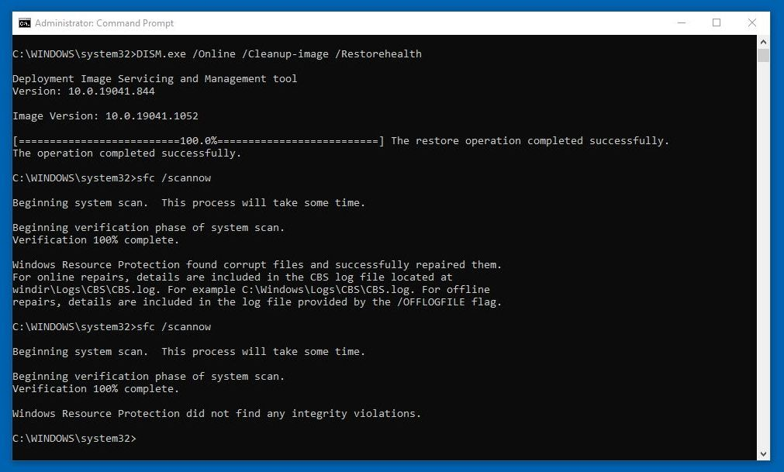
Run as Administrator

Slide 10
BIOS
The Basic Input Output System (BIOS) is code on a chip on the system motherboard.
When the system is powered on the BIOS is the first software that runs. It identifies the hardware, configures it, tests it, and connects it to the operating system for further instruction.
This is called the boot process.
[Video] what is bios
https://support.lenovo.com/videos/VID100790

Slide 11
BIOS Settings
Entering the BIOS setup utility allows you to change the boot process order as well as a variety of CPU settings.
Unified Extensible Firmware Interface (UEFI) is similar to BIOS, but has some advantages.
It can boot from USB disks, has a graphical user interface with network capability, and is backward and forward compatible.
Over time, UEFI is expected to replace direct access to the BIOS.

Slide 12
Getting Started: 2) Virtualization Enabled?
Hardware support for virtualization (Intel VT-x or AMD-v) is always required to run 64bit VMs, and any VM that uses more than one CPU core.
Virtualbox versions 5 and 6.0 (July 2020) can run 32-bit VMs with software virtualization on almost all hosts (no VT-x or AMD-V setting in the BIOS is required)
MyTyVM is one of the last 32-bit single-core VM Guest operating systems
Start Menu - Windows Admin Tools - System Info
at the bottom
Hyper-V - Virtualization Enabled in Firmware: Yes
Ready to go

Slide 13
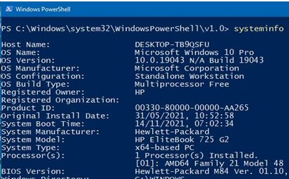
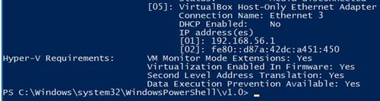
Powershell // Command > systeminfo
Good To Go!

Slide 14
Getting Started: 2) Virtualization Enabled?
Start Menu - Windows Admin Tools - System Info
at the bottom
Hyper-V - Virtualization Enabled in Firmware: No
You need to enable hardware support for virtualization in the host system BIOS.
Note your exact system model, then check how to get into the BIOS settings at boot time.
Once you get there you need to track down the setting, which is buried in a menu
There are examples at the end

Slide 15
Getting Started: 2) Virtualization Enabled?
To see if CPU supports virtualization in Linux, you need to check the file /proc/cpuinfo to see if it has virtualization flag(s)
Use this command as root to find host cpu manufacturer
grep --color "model name" /proc/cpuinfo
Use this command as root to verify that host cpu has support for Intel VT technology:
grep --color vmx /proc/cpuinfo
for AMD – V technology:
grep --color svm /proc/cpuinfo
https://www.cyberciti.biz/faq/linux-xen-vmware-kvm-intel-vt-amd-v-support/

Slide 17
Getting Started: 3) Install Virtualbox
The current version is recommended for download
Comes in two parts because of copyright
Platform Pack (main application) (Required)
Extension Pack (licensed) (Optional)
BE SURE to
Right-Click and Run As Administrator
when you install
Virtualbox works best from the default location – C:\Program Files
(You can put the VMs anywhere)
Minimum: VirtualBox 6.1.22 (released 29 April 2021)
VMM: Fixed guest OS hanging under certain circumstances when Hyper-V is present

Slide 18
Getting Started: 4) Create a VM
Download the Base.iso from http://my-tiny.net
and follow the pdf or the video

Slide 19
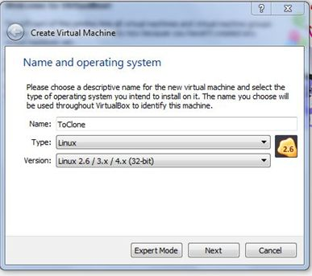
TinyNet: linux 2.6/3x/4x/ (32-bit)
When creating a VM, make sure you choose the proper version of the guest OS template
Choosing the correct template allows virtualbox to select the correct settings for other processor features - it's not just about 64bit capability any more.

Slide 20
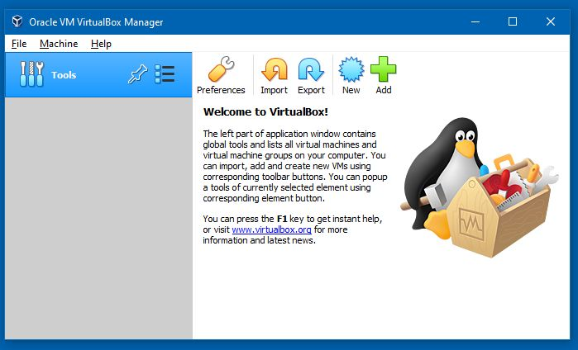
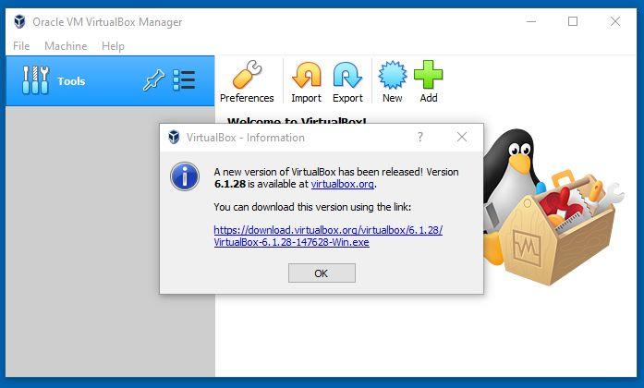
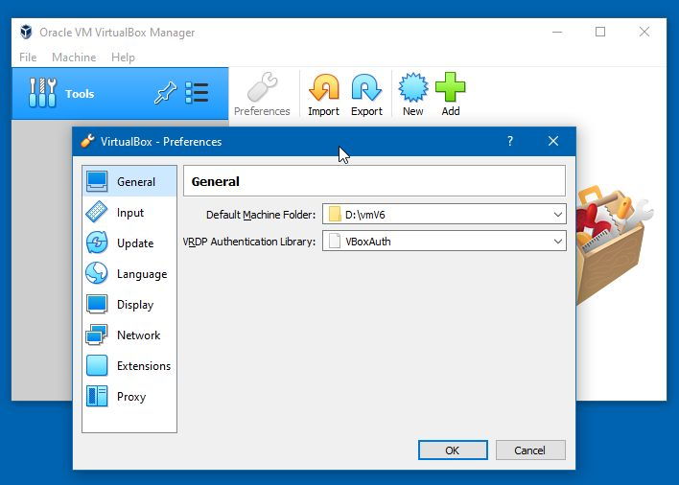
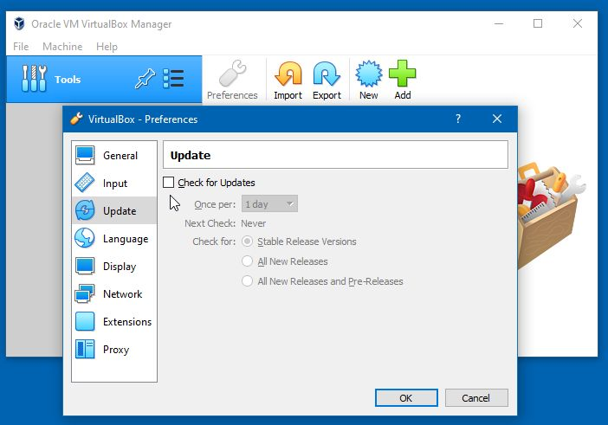
You can store your VMs anywhere by setting the Default Machine Folder
But Remember: Windoze may change drive letters for removable drives
Turn off checking for updates – they happen too frequently and the changes are usually insignificant
:Tips:

Slide 21
Caution!
Running VMs on a laptop:
Check your power settings – close lid, low battery, etc.
Never Hibernate, only Sleep
(“Hibernate” suspends too many host processes, and your VM will get corrupted – “Sleep” works well enough)
(or … just make sure you ALWAYS poweroff the VM)

Slide 22
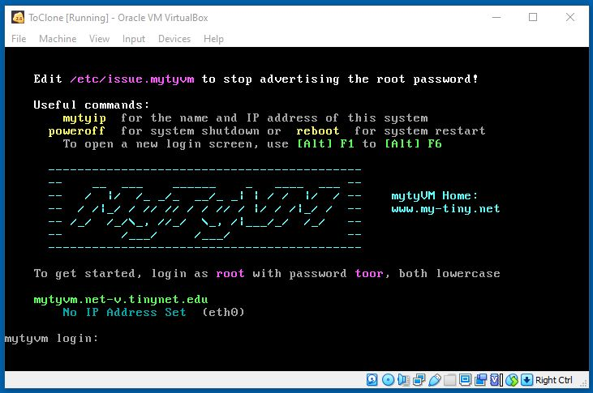
Logging in
:Tips:
Click this square icon to get rid of these bars
You will not see anything when you type the password
(to prevent “shoulder surfing”)

Slide 23
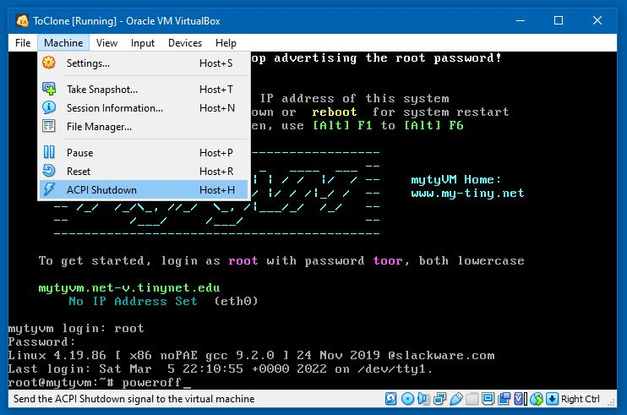
This just pulls the plug
This just pulls the plug
This is clean shutdown
This is clean shutdown
Clean Shutdown is important
Use poweroff at the shell prompt or
“ACPI Shutdown” from the VirtualBox Machine menu
Reset or closing the window is like a power blackout, and can corrupt files on the disk

Slide 25
Mac M1 Setup

Slide 26
Virtualbox only works on Intel CPUs
Running Virtualbox on Mac M1 (ARM processor)
Requires a Windows VM in an ARM hypervisor
UTM is free simple, and stable
A Windows 7 VM will minimise wasted resources
https://www.youtube.com/watch?v=Tp3REPE1WsQ
https://www.youtube.com/watch?v=FryuXhBWIV0
As Dimitry suggests, you need to use IE browser to download a proper browser, then get Virtualbox and a screenshot utility
This makes a good environment for all your VMs

Slide 27
TinyNet on Mac M1
UTM Windows 7 VM
https://www.youtube.com/watch?v=Tp3REPE1WsQ
https://www.youtube.com/watch?v=FryuXhBWIV0
Opera Browser: https://www.opera.com/computer/portable
Video capture for Opera: https://addons.opera.com/en/extensions/details/desktop-screen-recorder/
Irfanview (image capture and edit): https://portableapps.com/apps/graphics_pictures/irfanview_portable
Virtualbox (simple version for tinynet): https://download.virtualbox.org/virtualbox/6.0.24/VirtualBox-6.0.24-139119-Win.exe
Give it 2GB RAM

Slide 28
Other Distros on Mac M1
UTM Windows 7 VM: Give it 3 or 4 GB RAM
This allocation comes from installed RAM, so you need to find a balance – an Ubuntu VM will want 2 GB from the memory allocated to the UTM Win7 VM
Install the current version of Virtualbox
Lots of things in the Virtualbox version changelog are about better support for newer Linux kernels

Slide 30
Accessing BIOS Settings

Slide 31
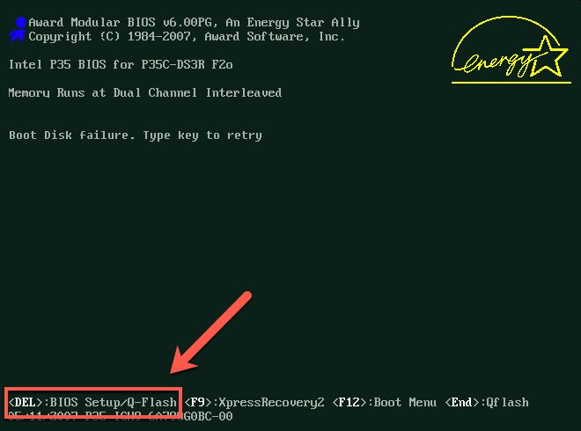
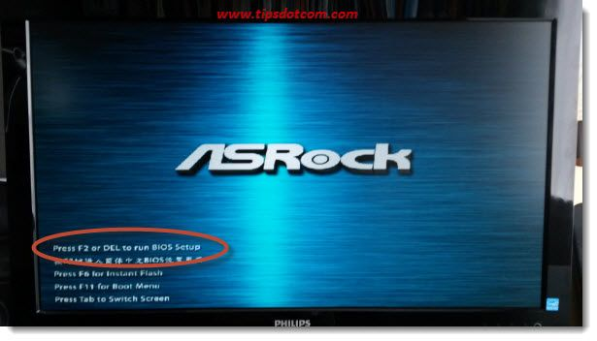
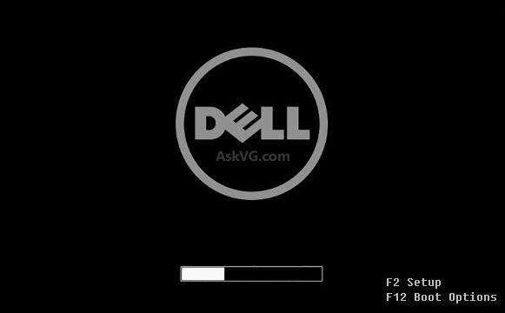
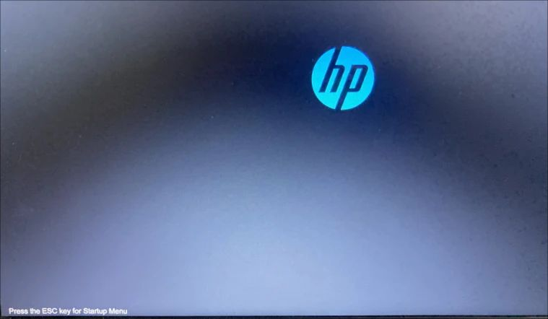
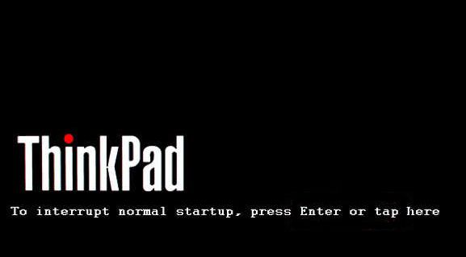
Keep pressing the key 2 times per second until the BIOS Menu is displayed
Normally the key to access the BIOS will be clearly displayed at bootup time

Slide 32
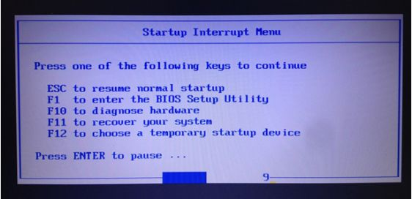
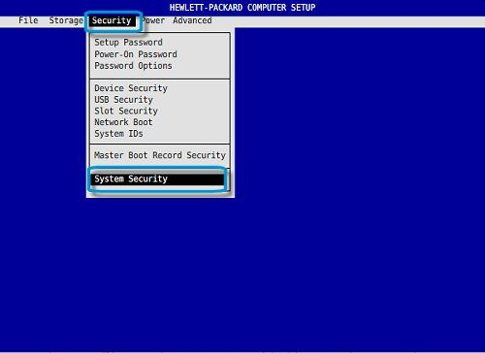
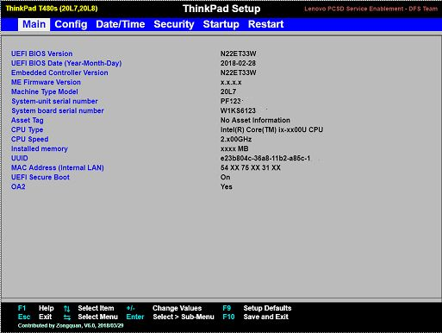
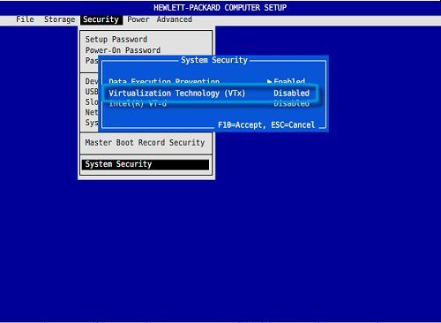
BIOS Setup Utility
Menus and keys are different for every make and model
Name and location of Virtualization Settings is different for every make and model

Slide 33
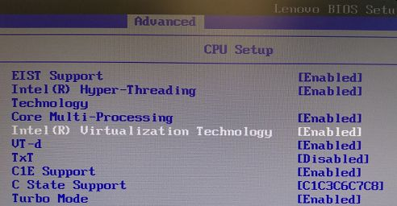
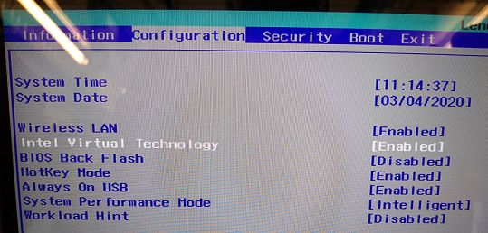
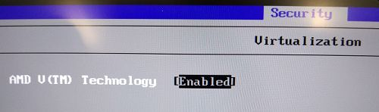
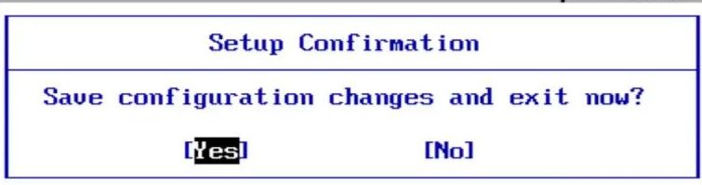
The option should be called something like
Virtualization
Intel VT-x
AMD V
Secure Virtual Mode
SVM Mode
The option is usually in
Security
Configuration
Advanced

Slide 34
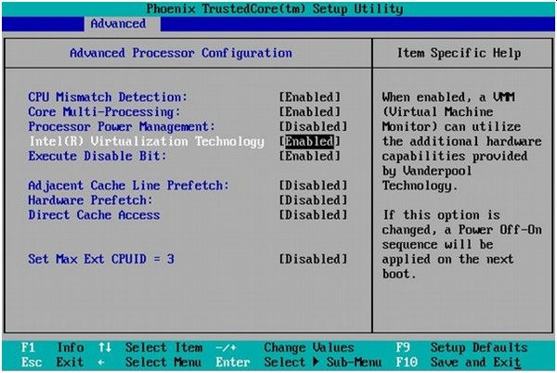
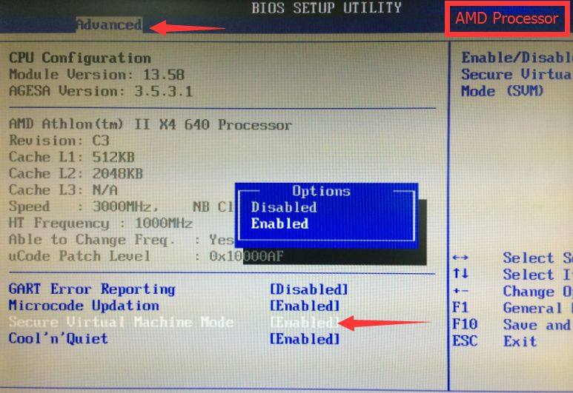
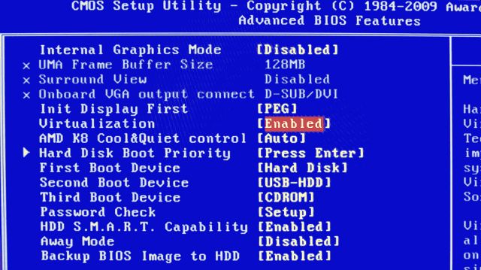
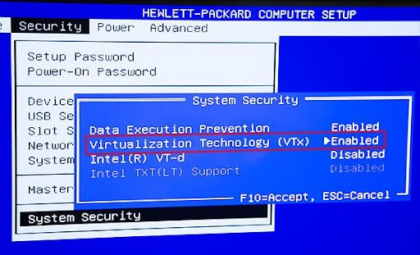
"Virtual Directed I/O" (Intel VT-d/AMD-Vi) is a different thing, the default is OK

Slide 35
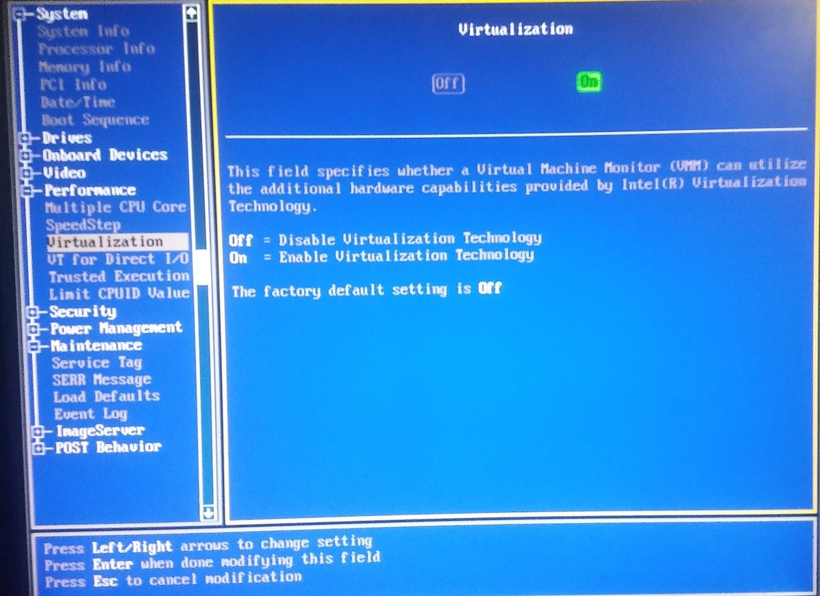
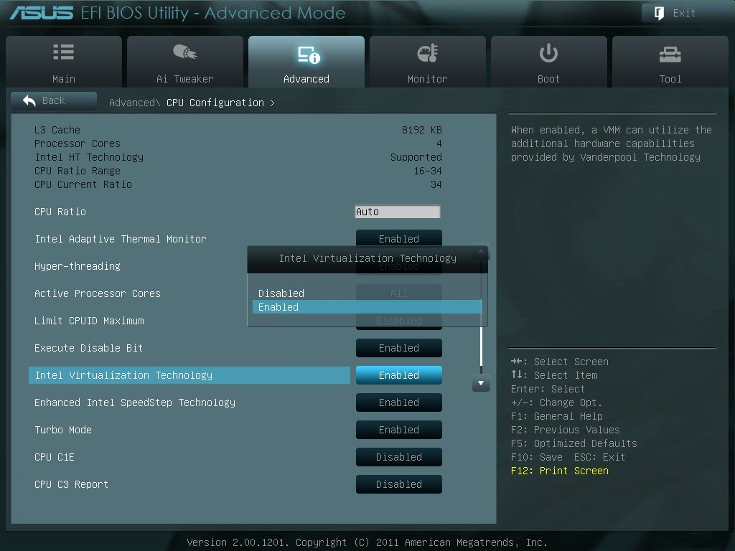
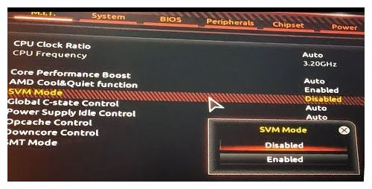

Slide 36
Getting Started: BIOS Settings
BIOS Settings
A full restart from power off is best after saving BIOS changes
just rebooting or resuming may not do the job. .

Slide 37
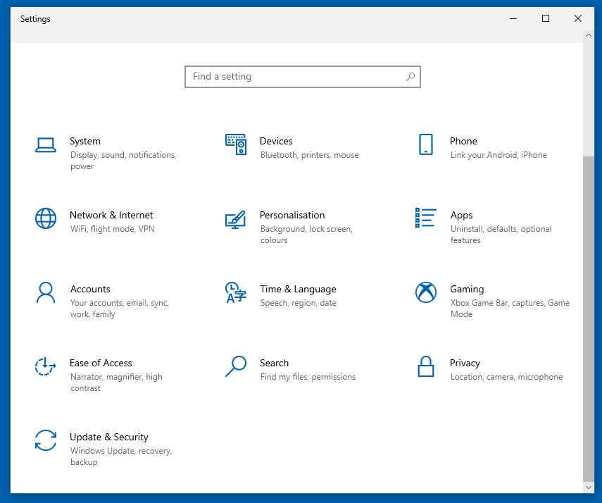
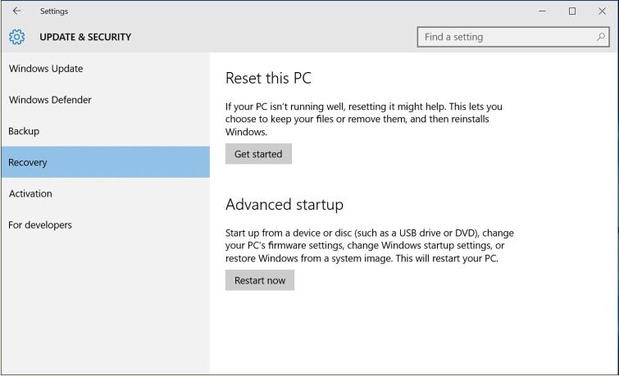
Access the BIOS from Windows
Start menu
Settings
Lots of people describe this process but forget to mention that UEFI is a BIOS setting

Slide 38
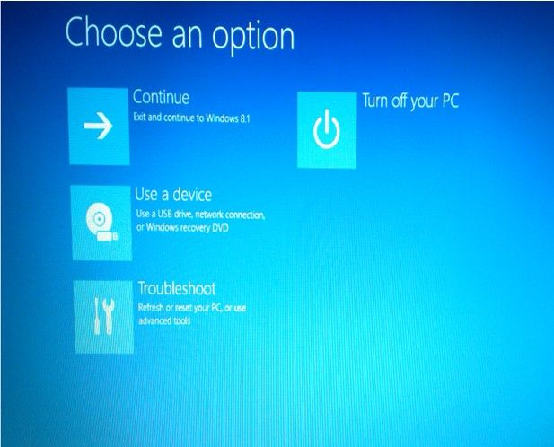
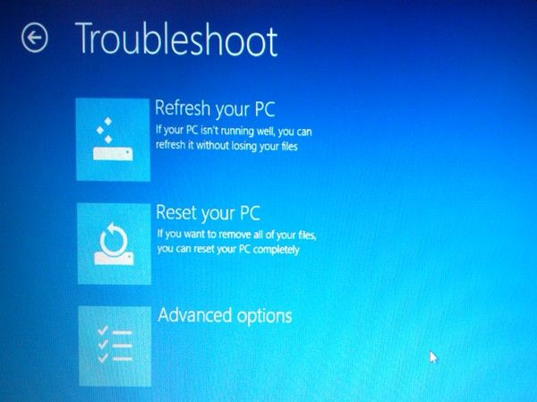
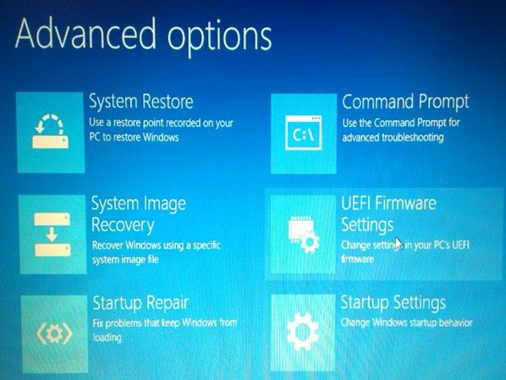
Access the BIOS from Windows
The UEFI option is not there unless UEFI is already Enabled in the BIOS
The final reboot puts you into the BIOS Setup Utility

Slide 39
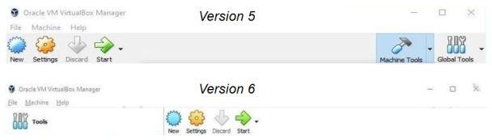
Vbox 5
Virtualbox 6 has a slightly different icon layout than the version 5 interface but it is not a problem.

